Slide 1
GIT HUB
Author: Srinivas Reddy. Balu

Slide 2
.git, clone and pull
First download git an install in machine.
Create one repo in Git manually by using create repo option in github.
Fork:
  Can be used to add the whole project from one git account into another git account.
Clone:
  Goto that repo and copy the https url and paste in git bash from local machine folder.
  Command: git clone url
  Now the git and local has connected and the repo code will be available into local folder.
  Command: ls -list the files
  cd filename to switch file
  cat filename –– to open file
  clear – to clear the console
. git :
  . It is a version control system. Can be used to commit the changes to local git and to generate the version id. This can be pushed to Git hub along with changes. Version id can be used for tracking purpose.
Pull:
  Can be used to get the new changes from repo into local.
  Command: git pull

Slide 3
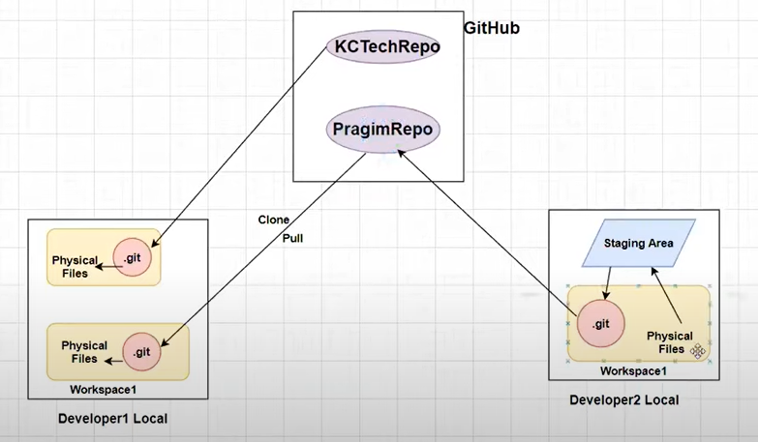
Git flow

Slide 4
Add, commit and push
Add:
  git add filename : Can be used to add the files to staging area.
Commit:
  git commit –m ‘message’: commit files to .git(local git repo) from staging area.
Push:
  git push origin master : to push the changes from .git(local git repo) to git hub.
  Origin is alias name of url where we clone this project.
Status:
  git status : to know the status of local changes.
Remote:
  git remote –v : to show the origin(url) on which we are working.

Slide 5
Empty repo setup steps
echo "# empty-repo" >> README.md
git init
git add README.md
git commit -m "first commit"
git branch -M main
git remote add origin https://github.com/SrinivasulaReddy-pixel/empty-repo.git
git push -u origin main

Slide 6
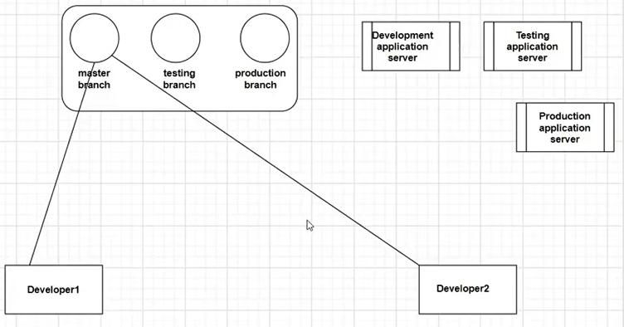
Branches

Slide 7
Branches
Branches
  A git branch is an independent line of development taken from the same source code.
  You can take advantage of branching when working on new features or bug fixes because it isolates your work from that of other team members.
  We can create an individual branch to each environment(testing, development).
  git branch : to list branches
  git branch name: creating a new branch
  Git checkout <branchname> : switching to another branch
  Git checkout –b <branchname>: create and switch to new branch
  Git branch –m <oldname> <newname>: renaming a branch
  Git branch –m <oldname> <newname>: Renaming current branch

Slide 8
Git Merge
Open master/main branch
  Do changes
  Git add .
  Git commit –m ‘msg’
  Git push origin main
Open other branch(testing)
  Git merge main/master
  Click Escape :wq (write quit)
  Git push origin testing
Merge and rebase:
  Both can be used to integrate the changes from one branch to other branch.
  Diff is merge can be used if we want to maintain history while working with big team, rebase can be used if we want to work with temporary branches and small team.

